Slide 1
Establishing a Just, Learning Culture
Dan Zhu
CSD-380 Module 9.2 Assignment
9/28/2025

Slide 2
Agenda
What is just culture?
Why do we need a just culture?
What are the principles of just culture?
What are the barriers to implement a just culture?
How to overcome the barriers?

Slide 3
What is just culture?
A just culture is to create a working environment where people can report concerns, errors, and mistakes without fear of punishment and focus on learning from the mistakes.
Dekker describes that Just Culture promotes learning, justice and safety, and reminds us that we can choose to be either backward-looking and retributive, or forward-looking and change-oriented (Psych Safety, 2025).

Slide 4
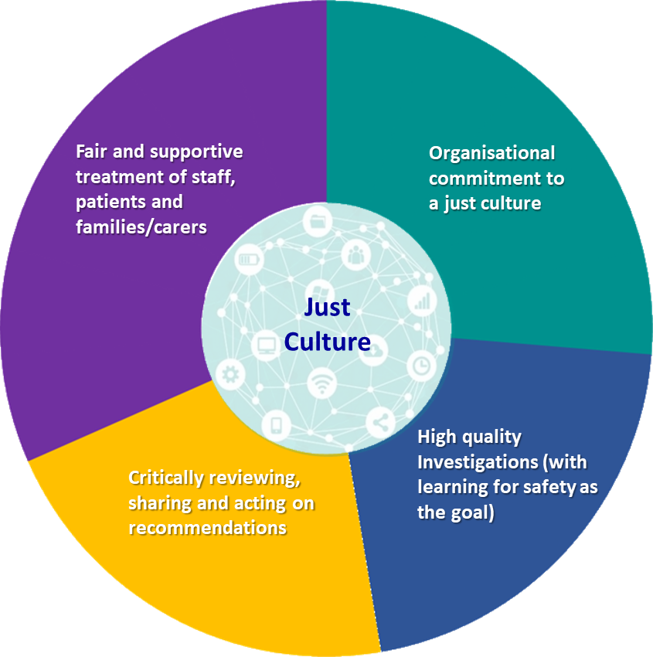
Four keys of Just Culture Assessment Framework
Just Culture Assessment Framework is short for JCAF and adopts from existing just culture model - HS Patient Safety Incident Response Framework, and prior measures like Petschonek et al (Improvement Academy).
Image from Improvement Academy

Slide 5
Why do we need a just culture?
Improved overall safety: It can lead to a safer work environment for employees and customers because employees are encouraging to report errors helping to identify potential safety hazards.
Increase accountability: Just culture discourage blame culture, but still emphasis accountability. People still need take blame on mistakes that are intentional, reckless, or blatantly disregard policies and procedures.
Higher employee morale: Just culture creates a supportive and respective work environment leading to a higher level of job satisfaction, mental health, engagement, and retention.
Better learning: Incidents and errors are great opportunity to learn not punishment. It can lead to increase the willingness of sharing information and insights.
Stronger reputation: Just culture can enhance a company’s reputation as a responsible and ethical employer, committed to safety, fairness, and transparency.
(Dingemans 2023)

Slide 6
What are the principles of just culture?
A culture of fairness
Openness
Learning
(Ingram, 2023)

Slide 7
What are the barriers to implement a just culture?
Fear of punishment: It could be the barrier of creating transparent and open culture.
Lack of trust: If employees don’t trust the leaders, they will hesitate reporting issues.
Resistance to change: Employees may resist to change if they don’t fully understand what is just culture.
Lack of leadership commitment: If the leadership is not committed to create a transparent and accountable culture, it will become the barrier of just culture.
Lack of resources: Just culture needs support of resources like trainings, error reporting systems and staff time. If organization is lack of those resources, it could be a barrier of just culture.

Slide 8
How to overcome the barriers?
Organization should create a transparent and open environment. According to Dekker, they should encourage a “fail forward” culture which mistakes are treated as opportunities to learn. Building trust with employees. When introduce just culture, let employees contribute to the change and explain them the benefits of just culture. Leaders should implement and change themselves first. Organization should provide trainings, tools to assist, and other resources which can support employee to adjust the culture.

Slide 9
Resources
Improvement Academy. (n.d.). A just culture network. Improvement Academy. Retrieved from https://improvementacademy.org/networks/a-just-culture-network/
Ingram, C. (n.d.). Breaking down barriers: Realising just culture. LinkedIn. Retrieved from https://www.linkedin.com/pulse/breaking-down-barriers-realising-just-culture-chris-ingram
Olmstead, L. (2024, December 23). How to create a learning culture: 18 best practices. Whatfix. Retrieved from https://whatfix.com/blog/learning-culture/
Pilots Who Ask Why. (2023, May 15). The power of just culture: Killing the blame game. Pilots Who Ask Why. Retrieved from https://pilotswhoaskwhy.com/2023/05/15/the-power-of-just-culture-killing-the-blame-game/
Psychsafety. (2025, May 23). Just culture: Why just culture isn’t sticking. PsychSafety. Retrieved from https://psychsafety.com/just-culture/

Slide 10
Thank you

